Slide 1



Slide 2
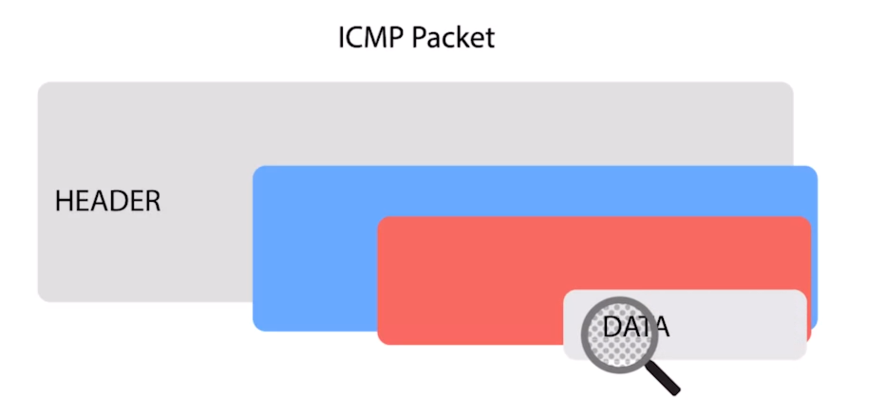
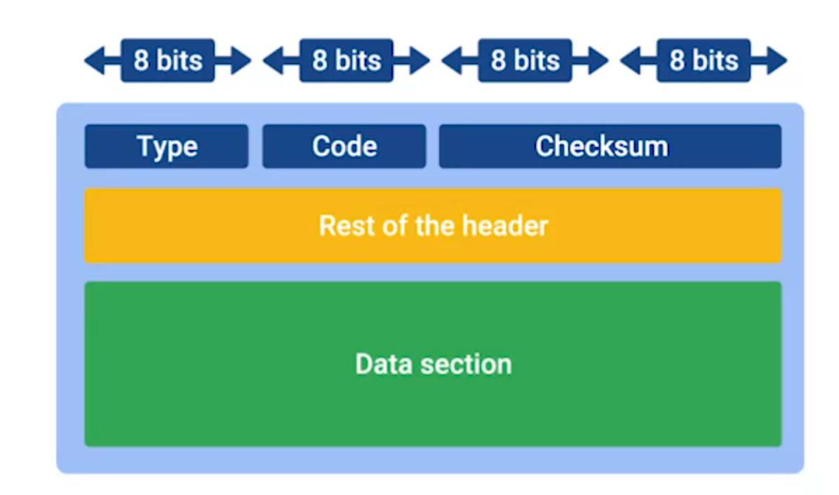

ICMP(Internet Control Message Protocol)

Slide 3


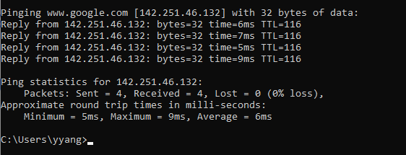
Ping
Determine whether you can reach a certain computer, and know the general quality of the connection
In windows, ping tool would send 4 Echo Request. In Linux, user have to interrupt it manually to make it stop.

Slide 4
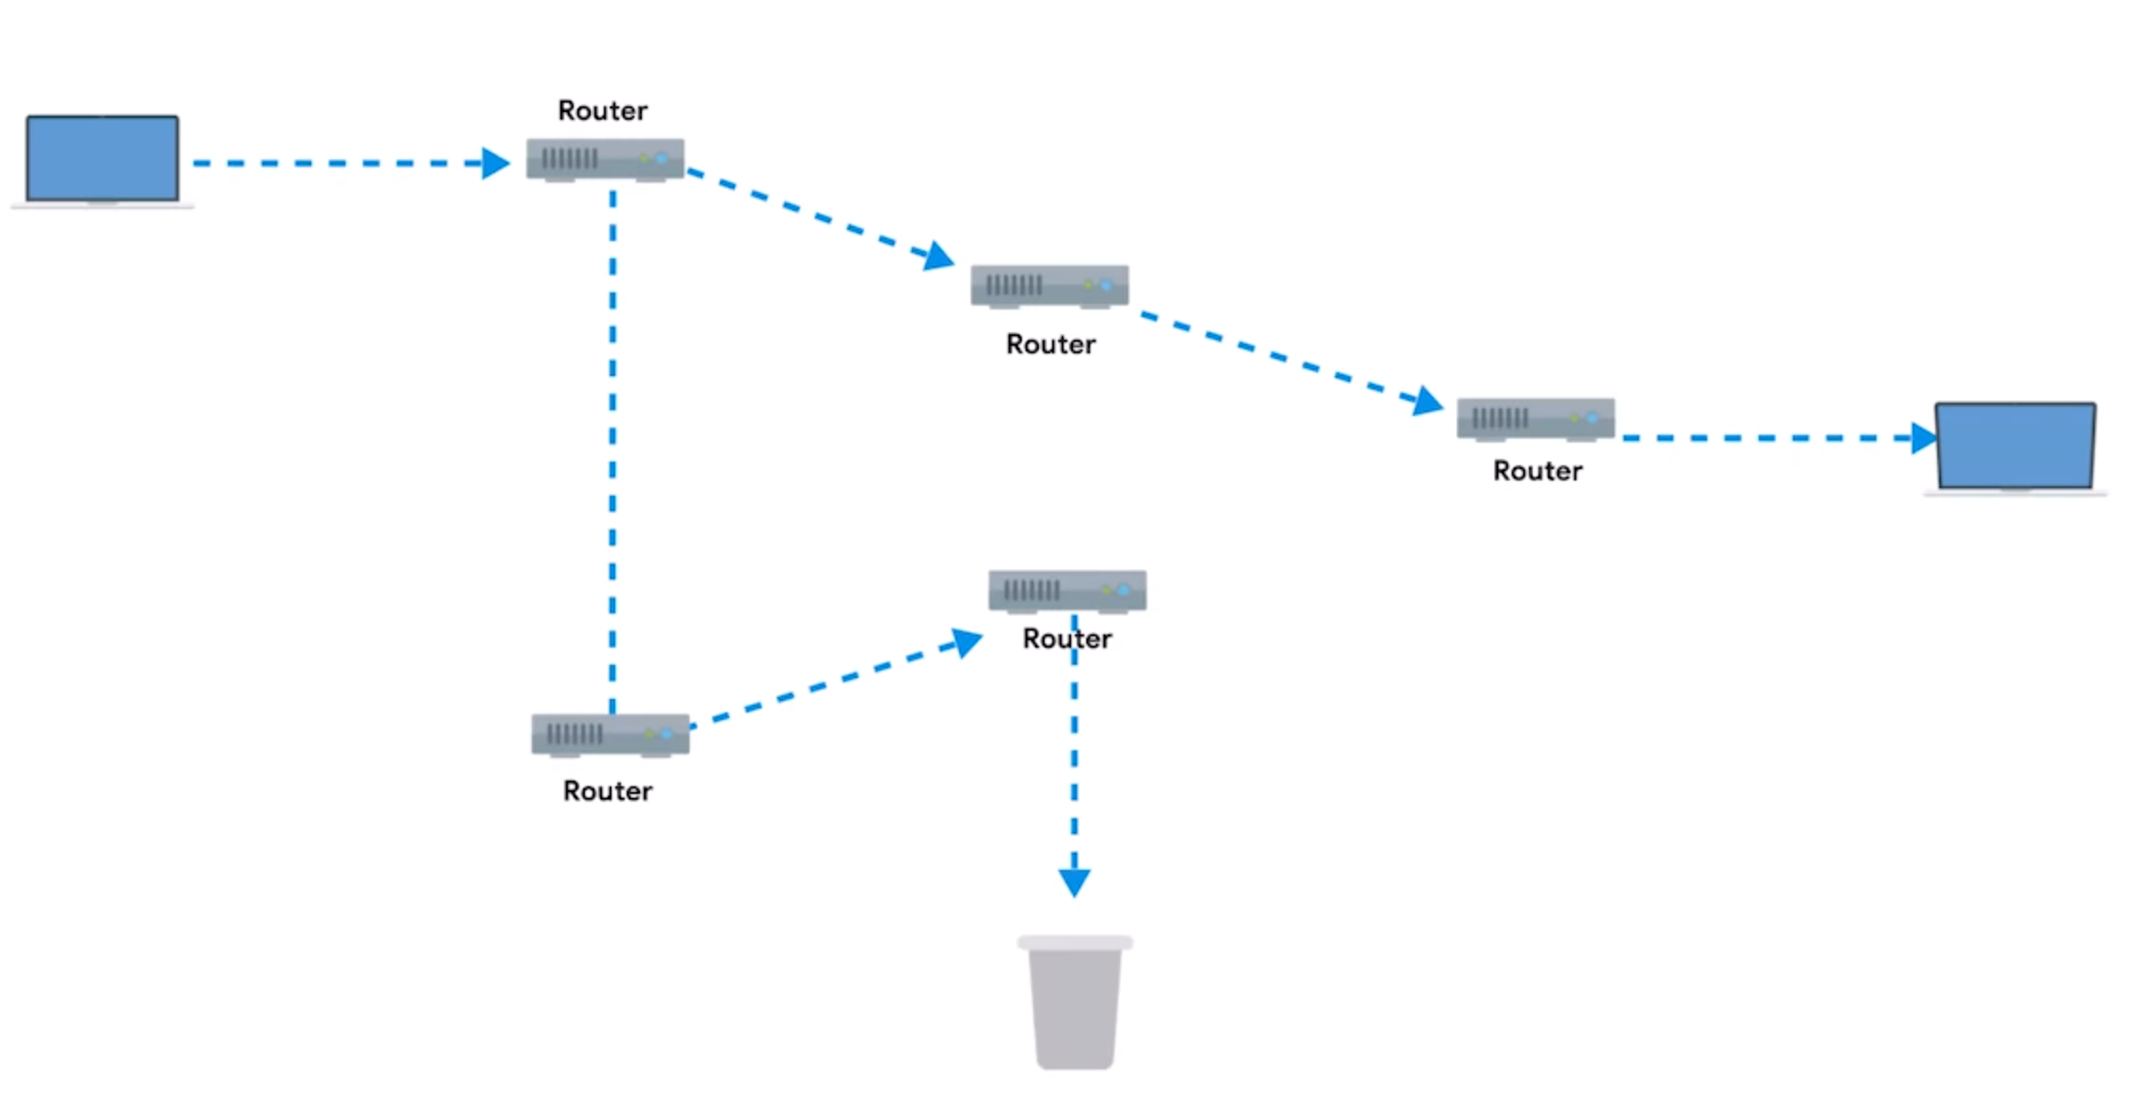
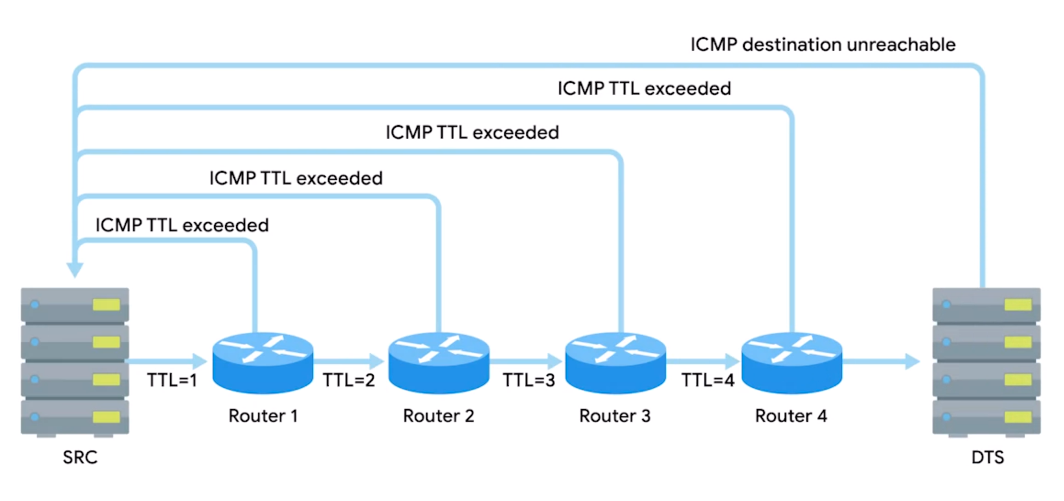

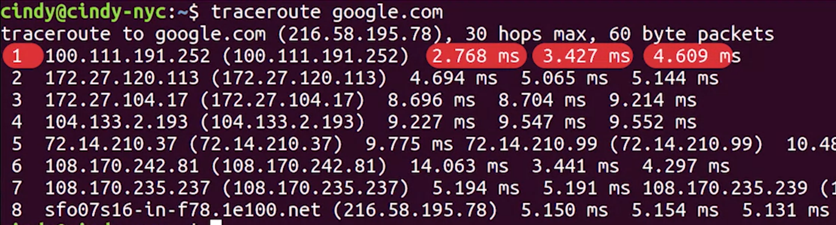
Traceroute
Ping could only tell you the overall quality of the connection but would not let you know which node is unreachable when disconnection happened. Traceroute is the solution.
Traceroute set different TTL (when TTL reach to 0, the data would be discarded, and send back “time out” message to original node) to get the time of data delivery to each node

Slide 5
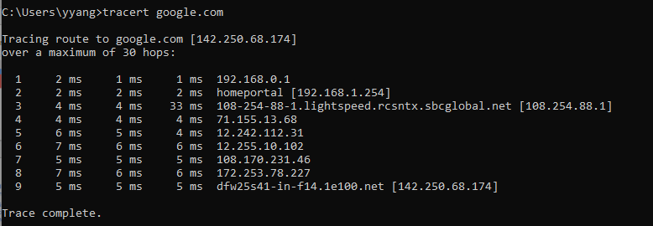
Traceroute
In windows, it has a shorter name, tracert
Instead of normal traceroute, “pathping” in Windows and “mtr” in Linux and MacOS act as long running traceroutes

Slide 6
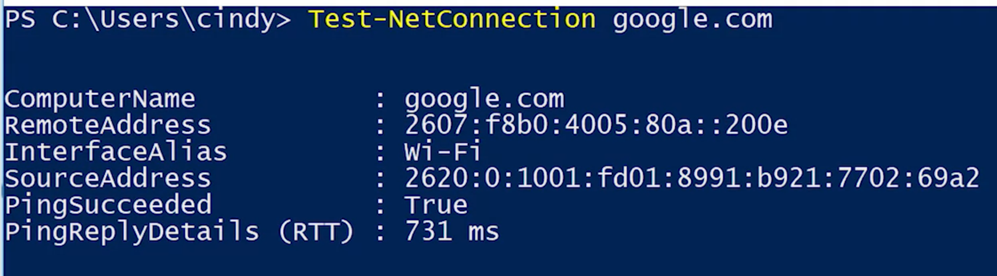
Testing Port Connectivity
The previous methods are used for network layer, but sometimes the error may occur at transport layer. For those problems, there are two powerful diagnose tools:
Netcat – Linux /MacOS (nc)
If it works (connection established), we will see a blinking cursor waiting for more inputs, otherwise the command would exit. (-v for verbose, -z for zero input and output)
2. Test-NetConnection - Windows

Slide 7


Supplemental Reading for Testing Port Connectivity
Sometimes, you need to know if network connectivity is working at the transport layer. For this, there are two super powerful tools at your disposal: Netcat (nc) on Linux and macOS, and Test-NetConnection on Windows.
The Netcat tool can be run through the command nc, and has two mandatory arguments, a host and a port. Running this command would try to establish a connection on port 80 to google.com:
If the connection fails, the command will exit. If it succeeds, you'll see a blinking cursor, waiting for more input. This is a way for you to actually send application layer data to the listening service from your own keyboard. If you're really only curious about the status of a report, you can issue the command, with a -z flag, which stands for zero input/output mode. A -v flag, which stands for verbose, is also useful in this scenario. So now, the command looks like this:
By issuing the netcat command with the -Z and -V flags, the command's output will simply tell you if a connection to the port in question is possible or not, like this:

Slide 8
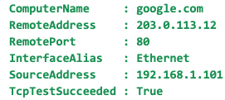
On Windows, Test-NetConnection is a command with some similar functionality. If you run Test-NetConnection with only a host specified, it will default to using an ICMP echo request, much like the program ping. But, it will display way more data, including the data link layer protocol being used. When you issue Test-NetConnection with the -Port flag, you can ask it to test connectivity to a specific port. For example, this command tests a TCP connection to google.com:
Test-NetConnection will return output that looks something like this:
It's important to call out that both netcat and Test-NetConnection are way more powerful than the brief port connectivity examples we've covered here. In fact, they're such complex tools that covering all of their functionality would be too much for one video. You should read up about all of the other things these super powerful tools can do in the Wikipedia article for Netcat (nc), and in the documentation for Test-NetConnection.

Slide 9
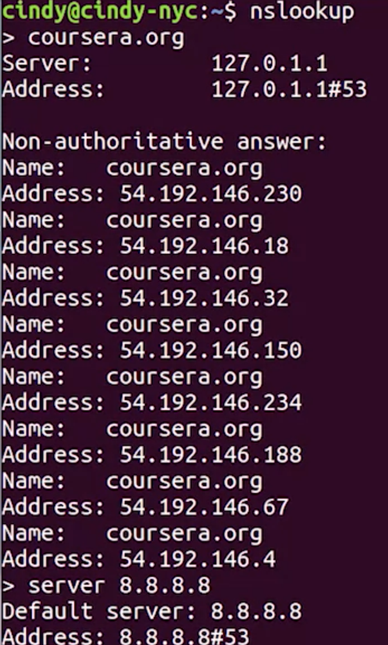
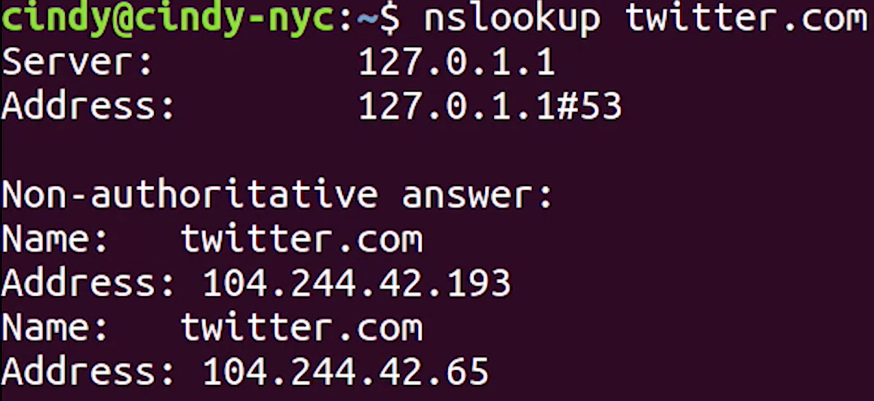
Name Resolution Tools
Nslookup – works for all operation system (check the lookup table)
For activating the interactive model, just type nslookup and hit the enter

Slide 10

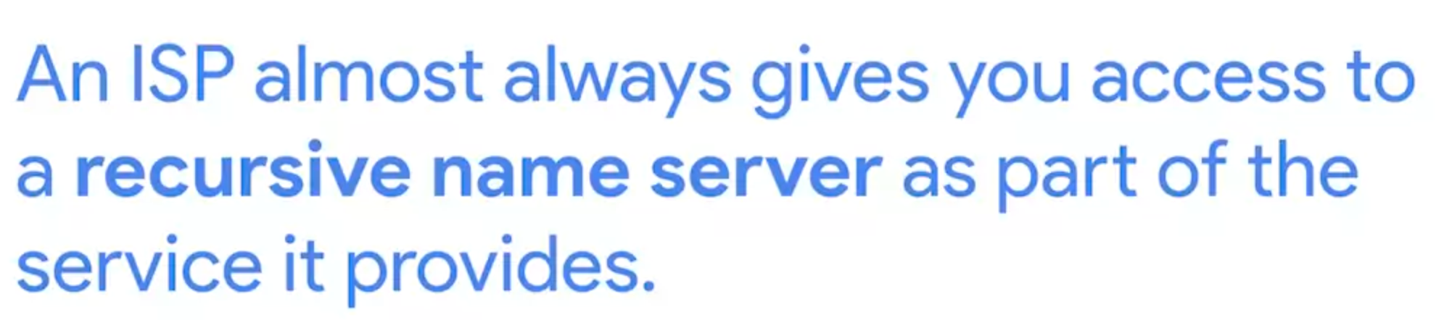

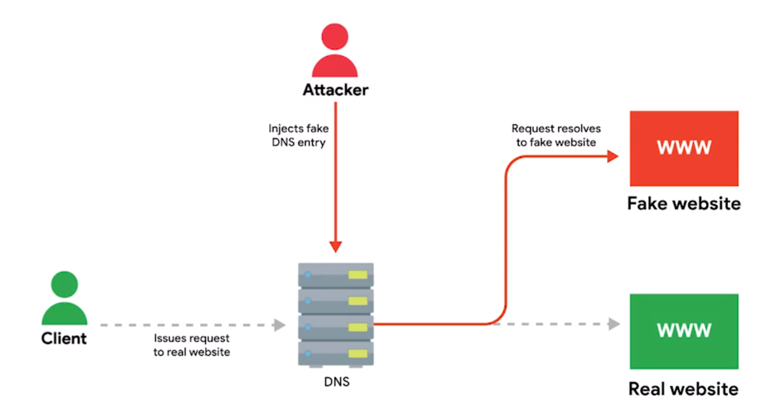
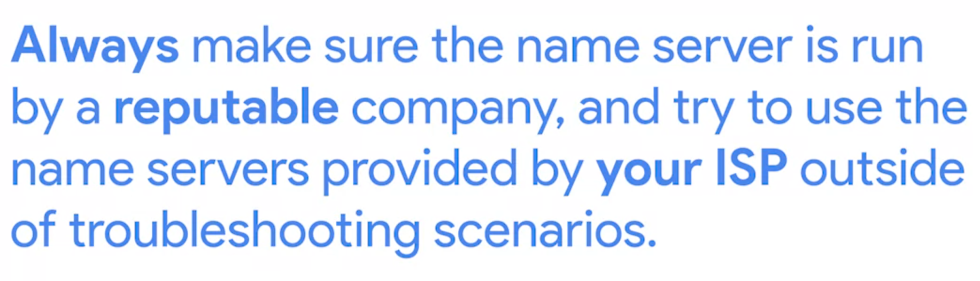
Public DNS Servers
Google host their free DNS server at 8.8.8.8 and 8.8.8.4
Internet Service Provider (ISP)

Slide 11



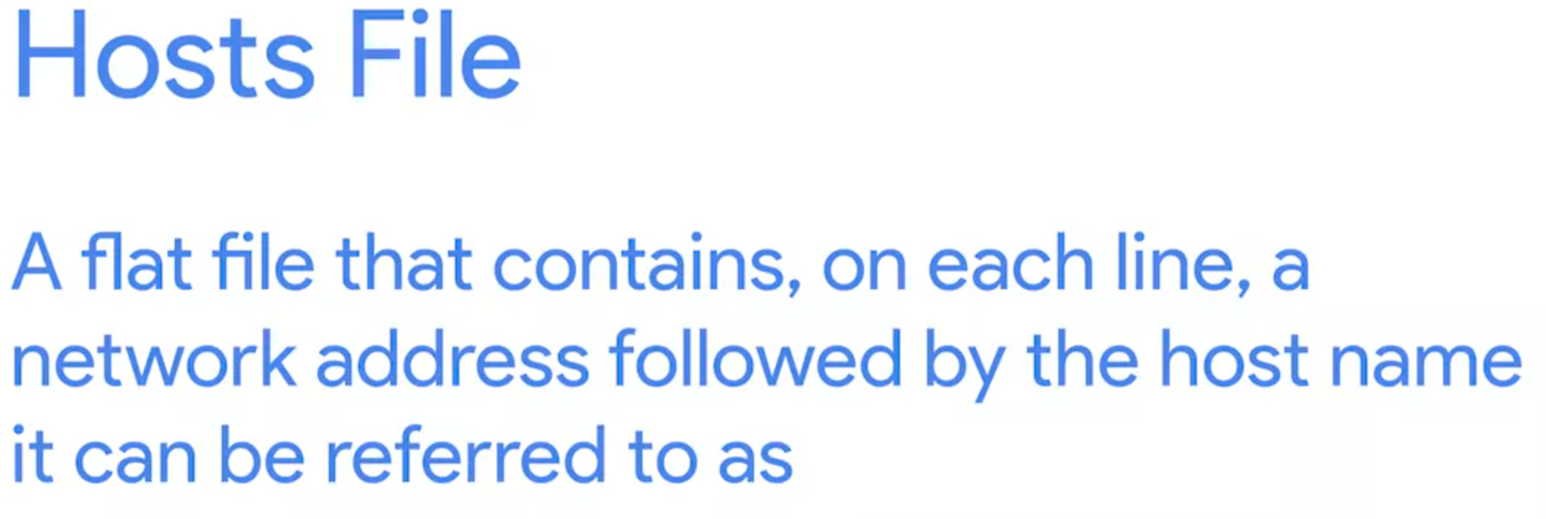
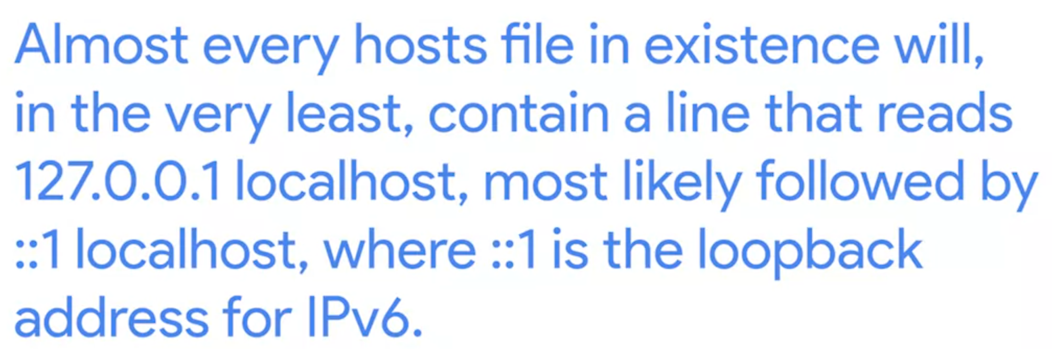
DNS Registration and Expiration
Hosts Files
For IPV4, loopback address is 127.0.0.1.
Like system variable, for example: 1.2.3.4 Webserver, then you could type ping Webserver, it would automatically connect to 1.2.3.4

Slide 12

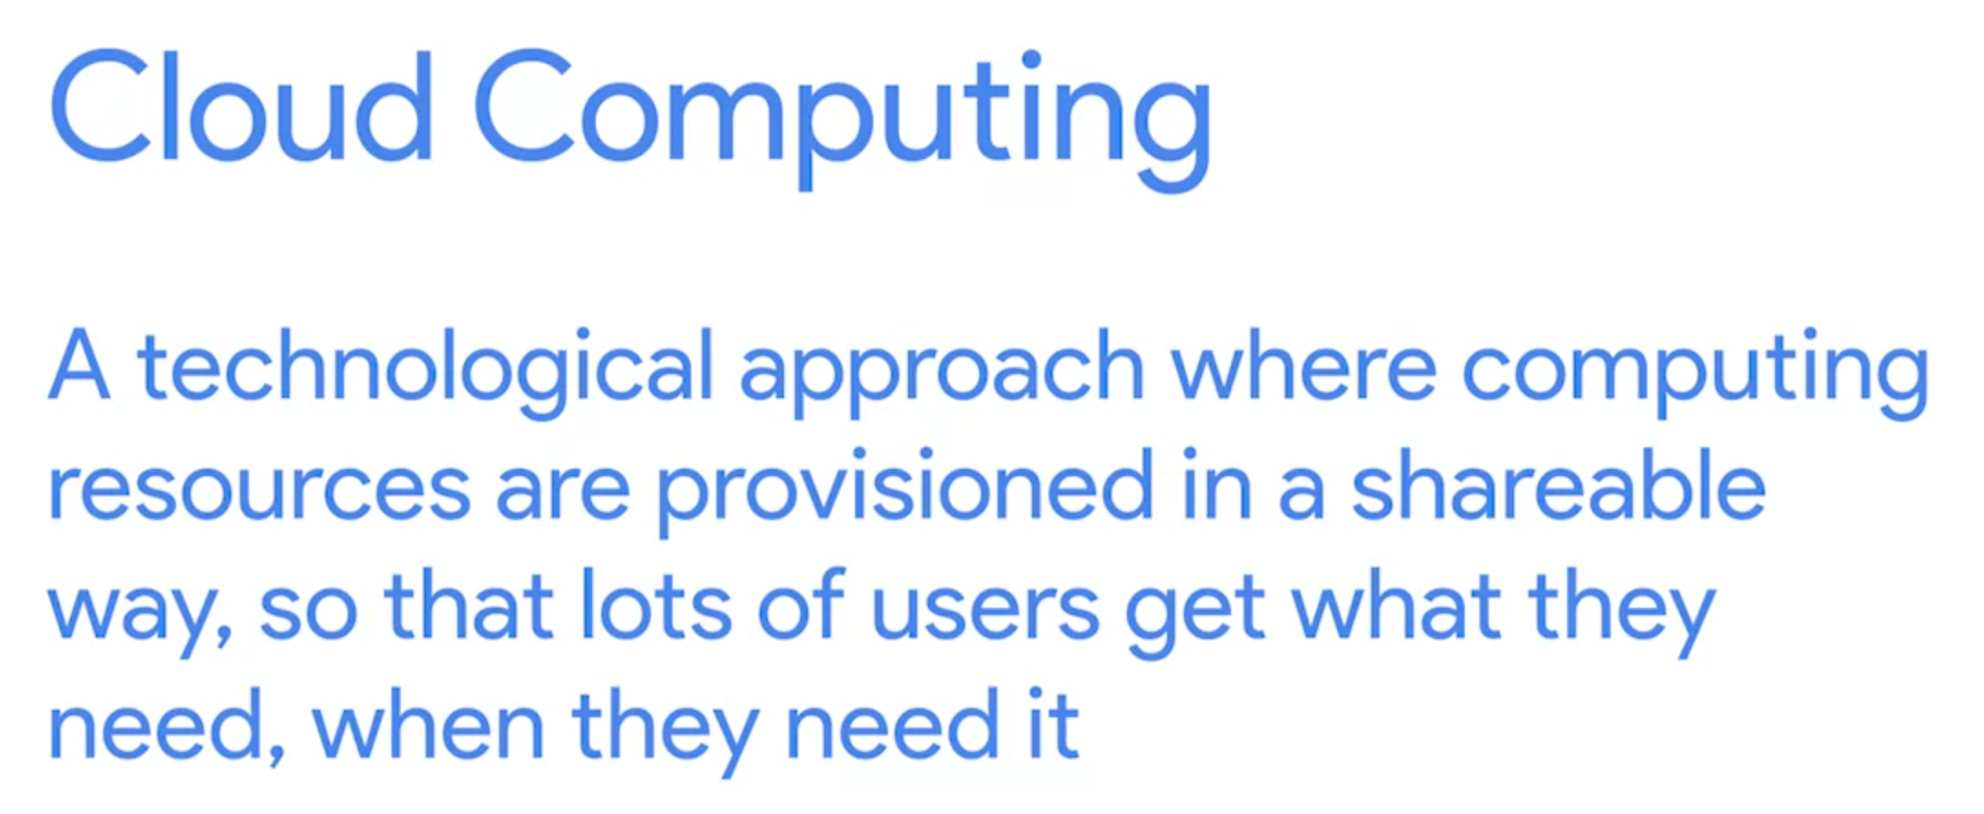
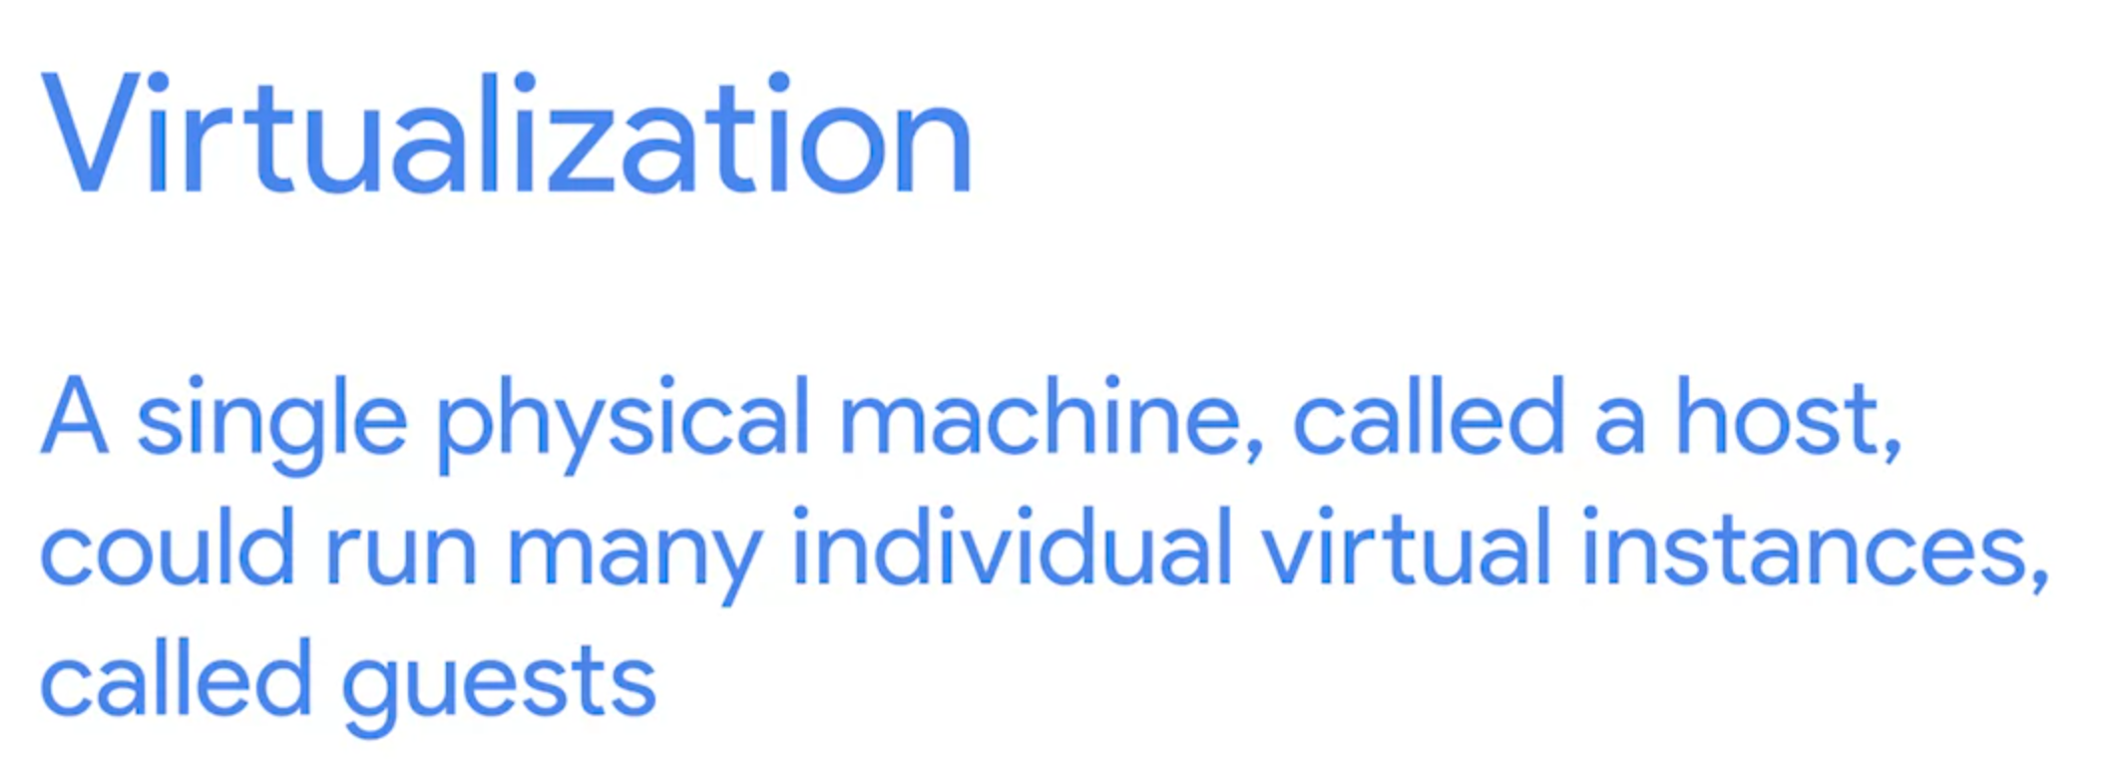
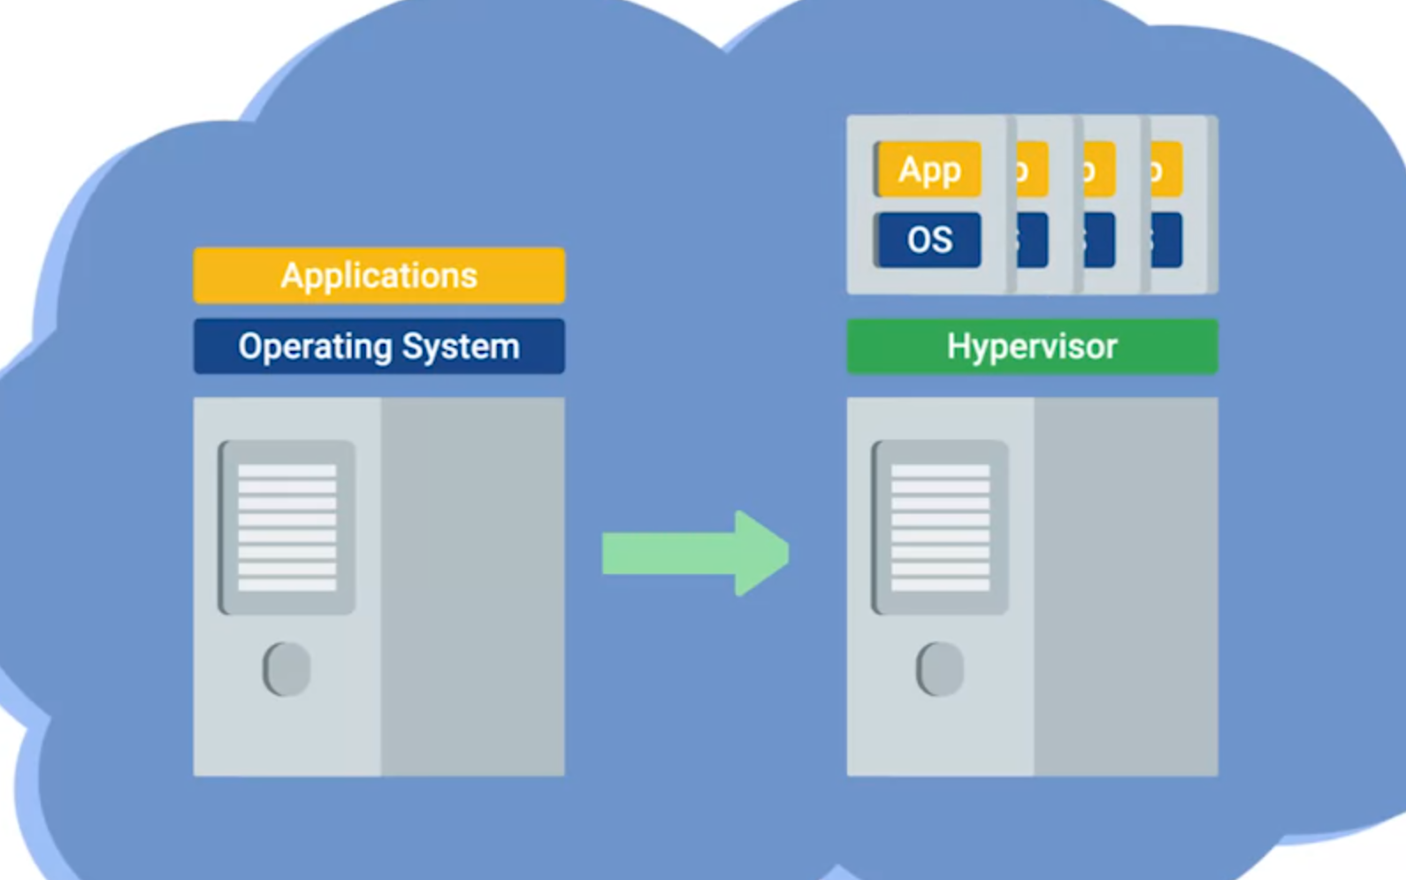
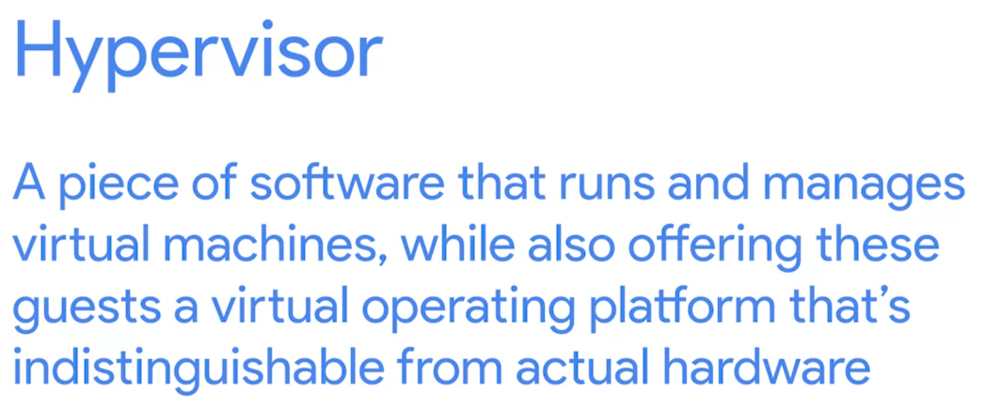
What is The Cloud?
Realize it by hardware virtualization

Slide 13
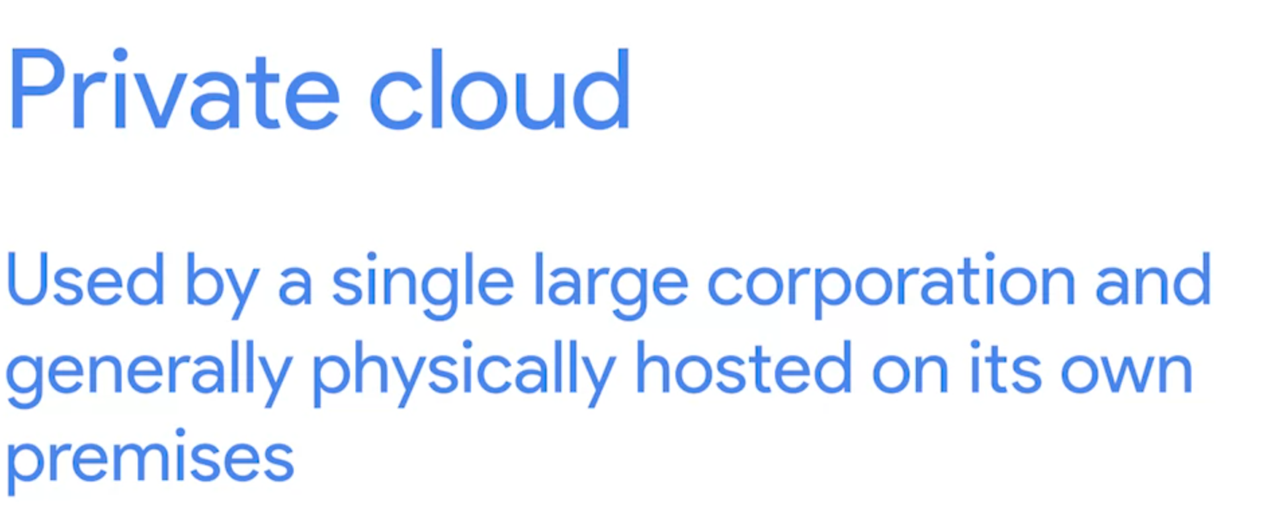
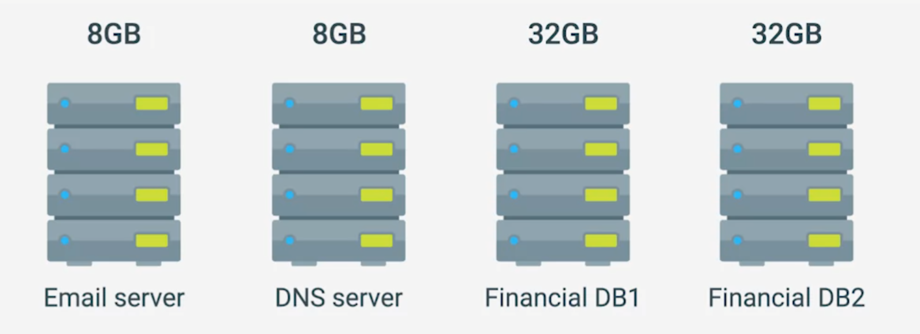
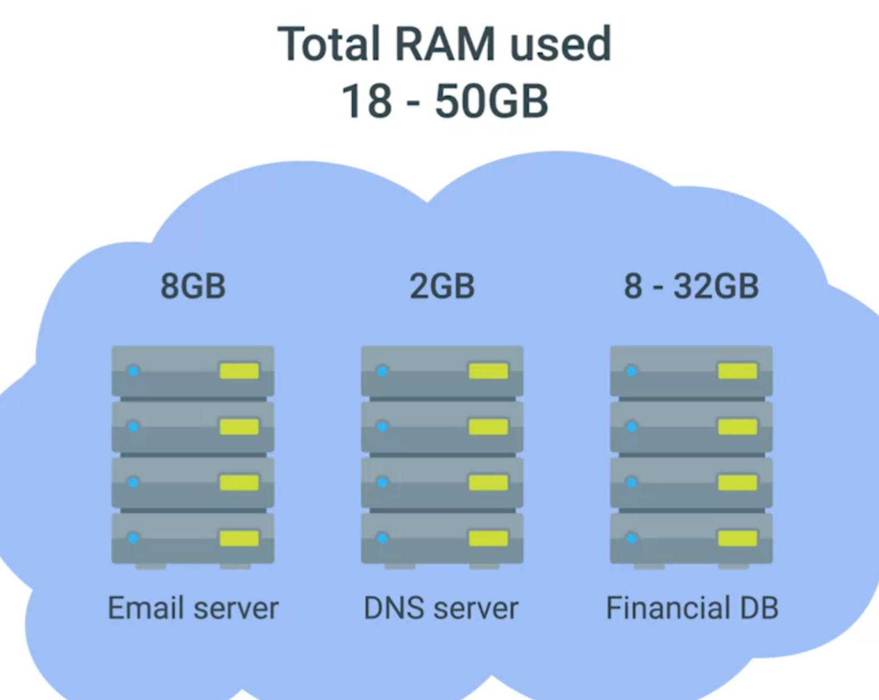

Without cloud (hardware virtualization) if we want to host a server, we need
Email server (works on windows)
DNS Server (Works on Linux)
Database Server (Works on Linux)
Backup Server for Database
Total 80 GB Ram are required, but half of them are rarely used

Slide 14
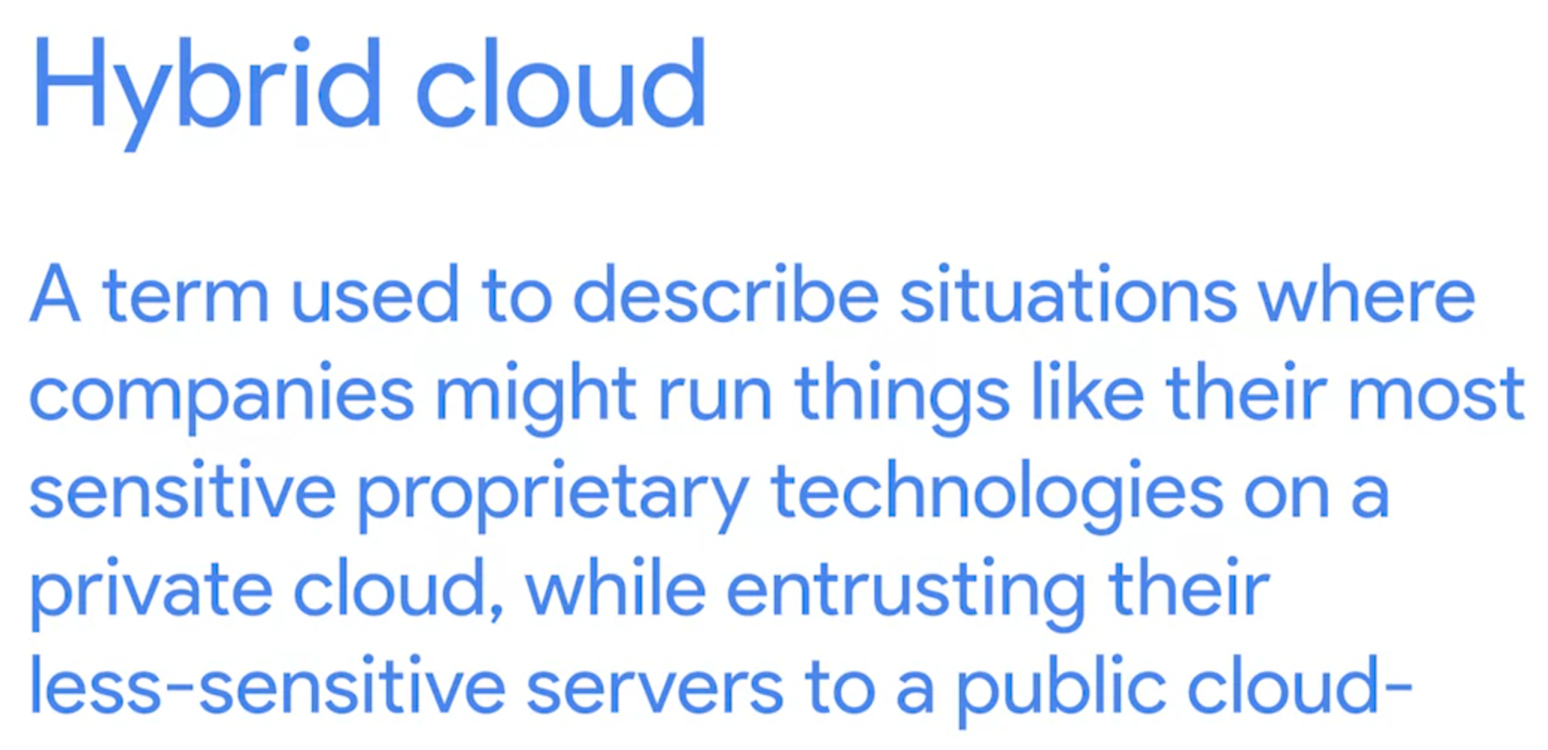
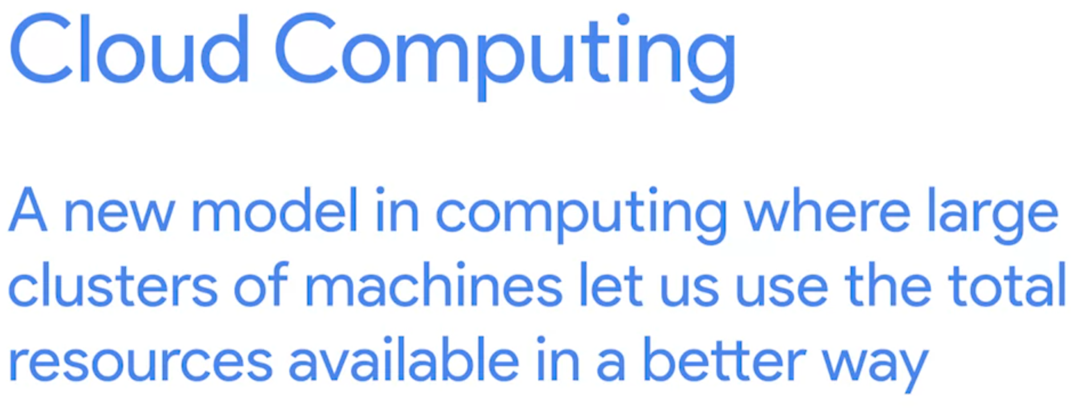
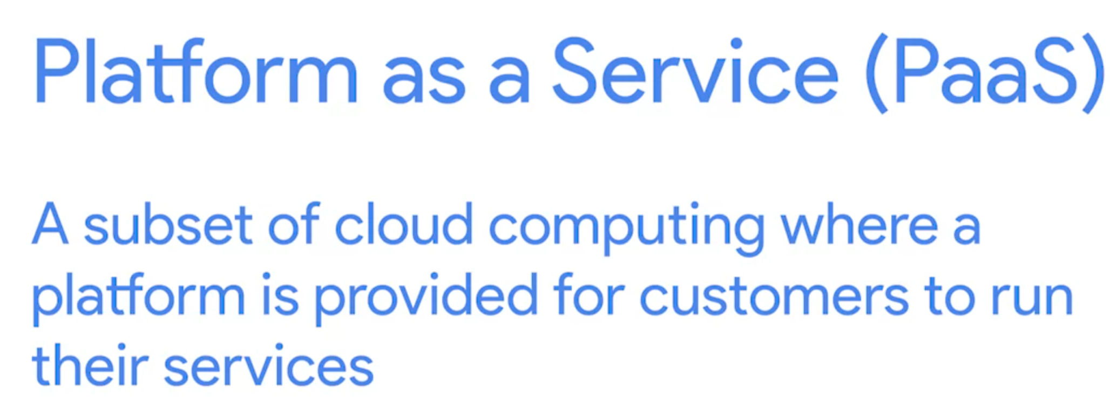
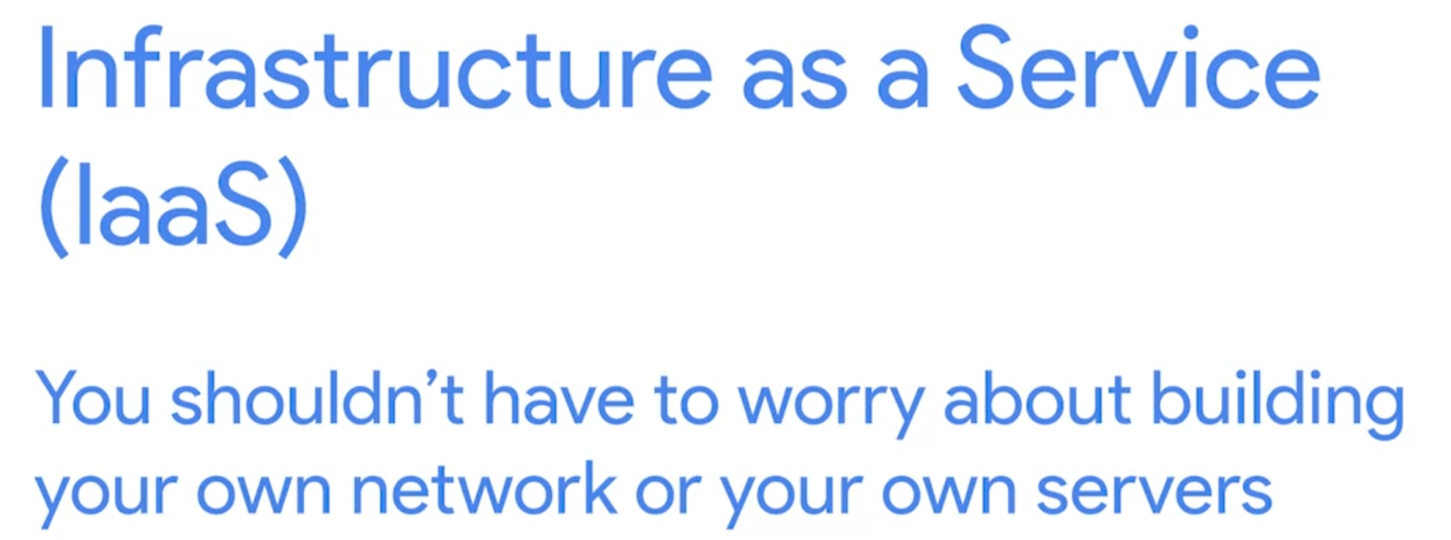
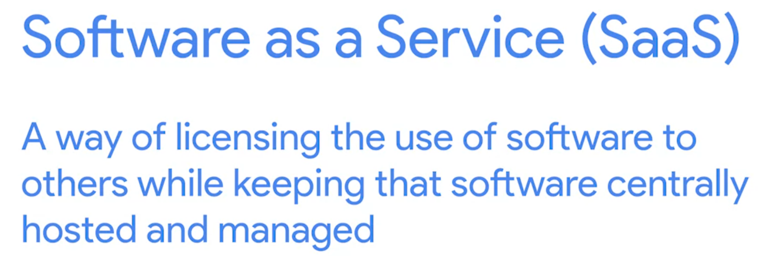
Platform as a Service (Paas)
Software as a Service (Saas)

Slide 15
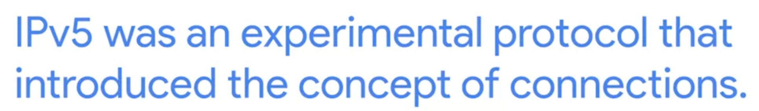
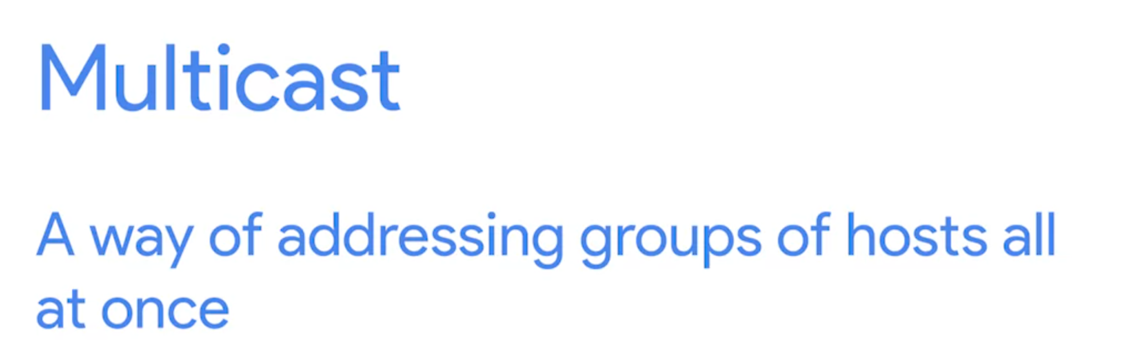
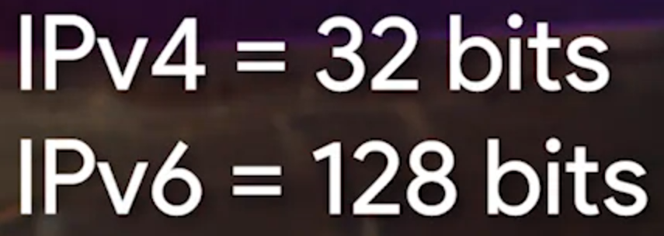

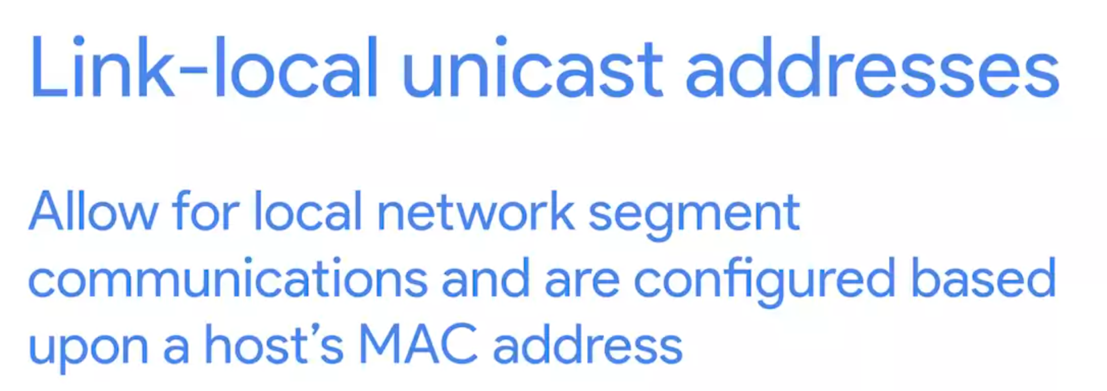
Cloud Storage
IPV6
Use the cloud providers’ protocol to keep user’s data
Secure
Accessible
Available
Remove the leading 0
Replace “all 0” as “::”
FE80:: reserves for link-local unicast
Every address start with FF00: is reserved for multicast
Lookback address:

Slide 16

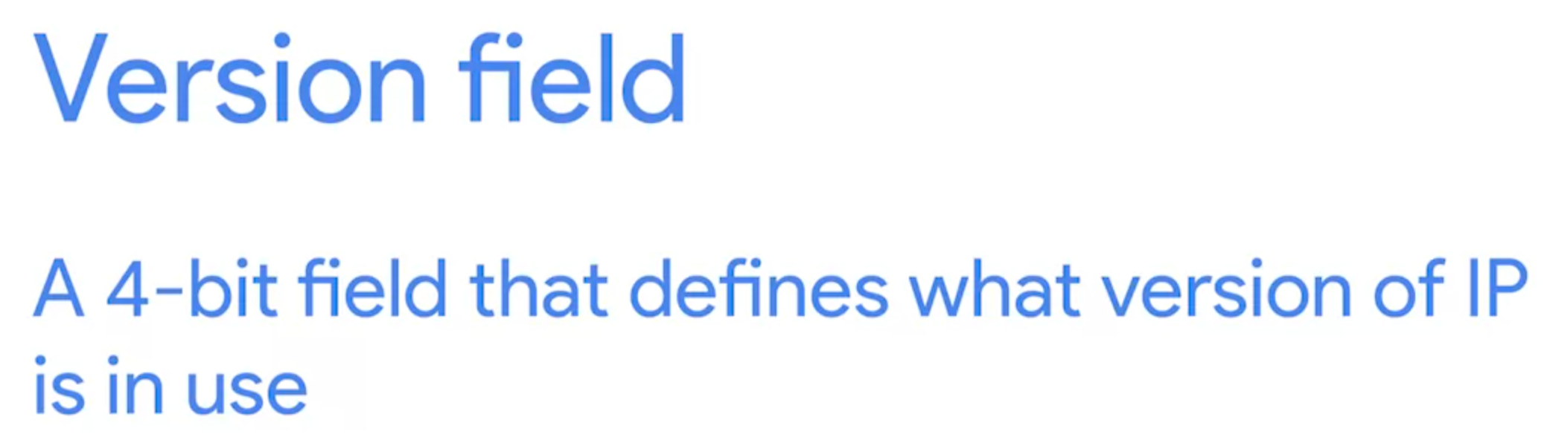

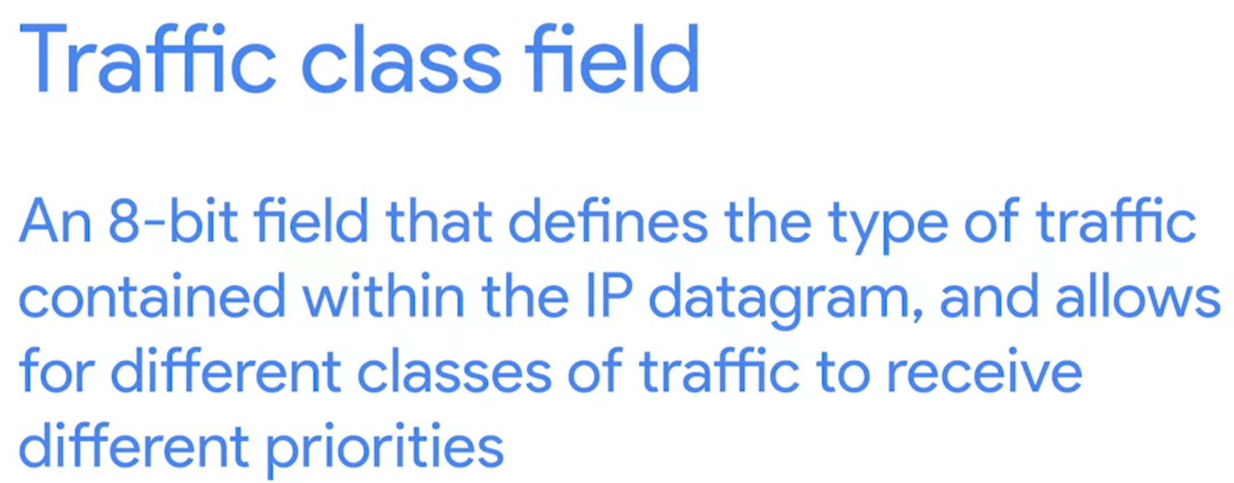


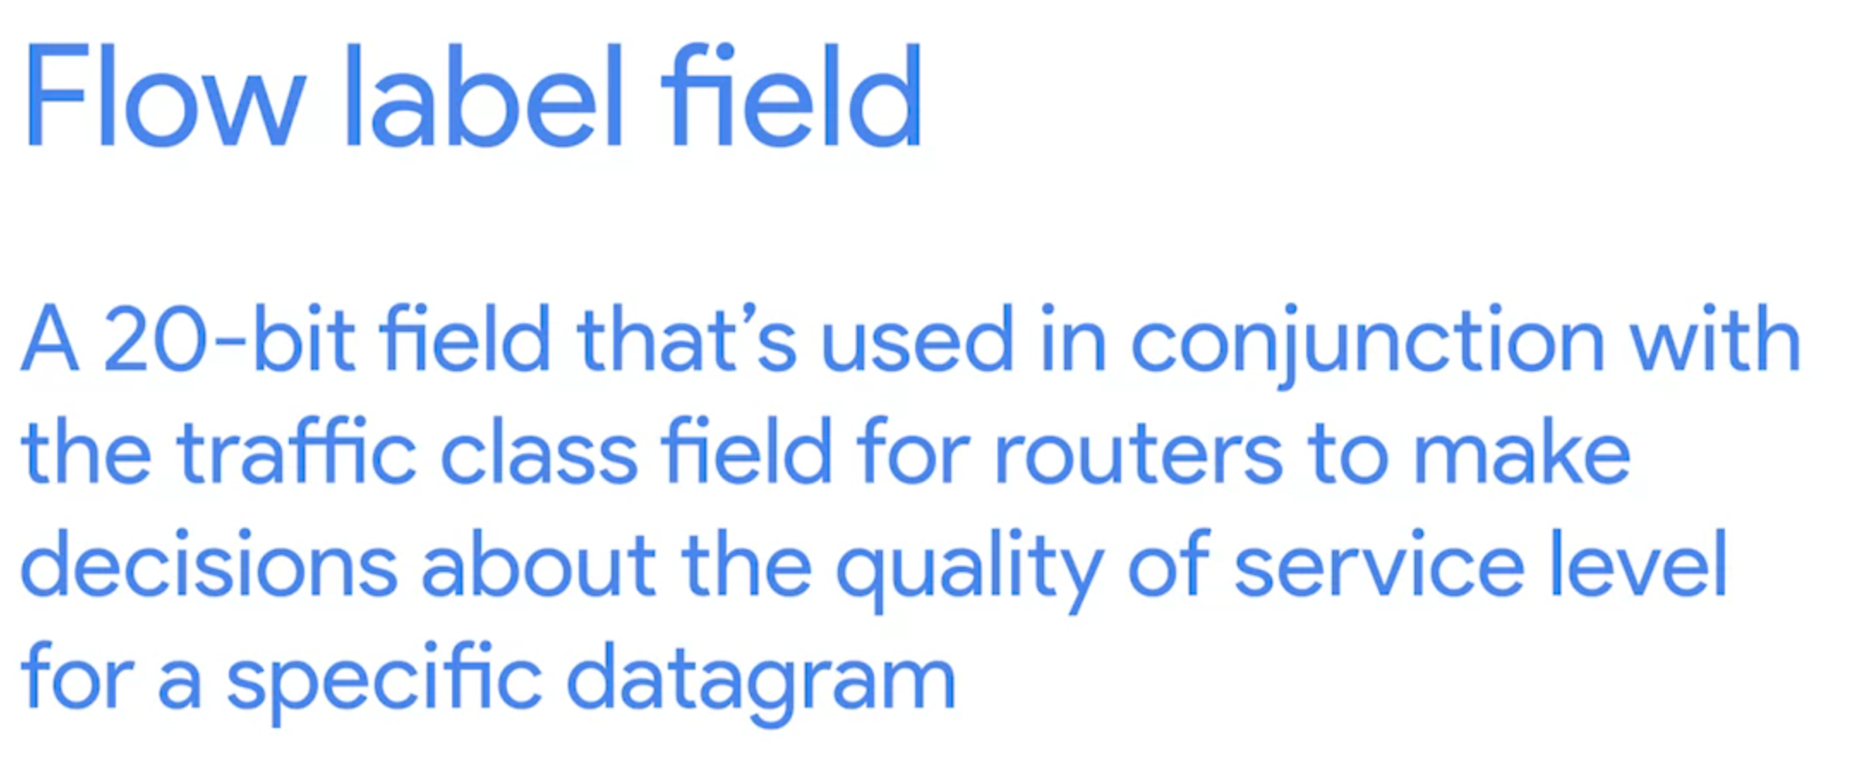
IPv6 Headers

Slide 17
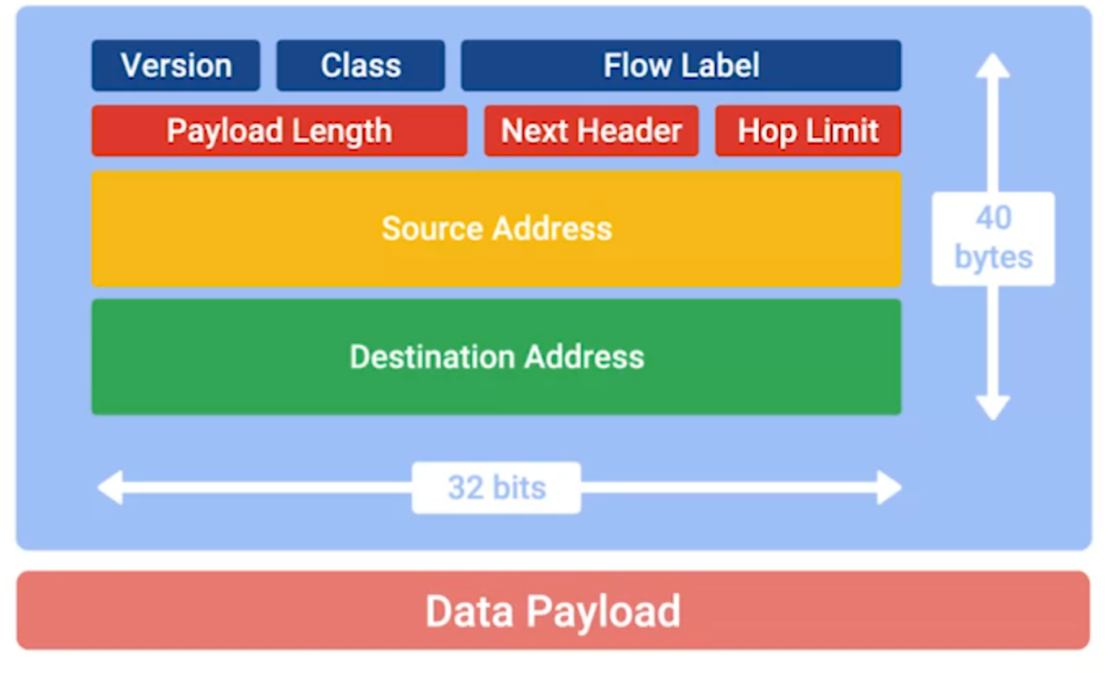
IPv6 Headers

Slide 18
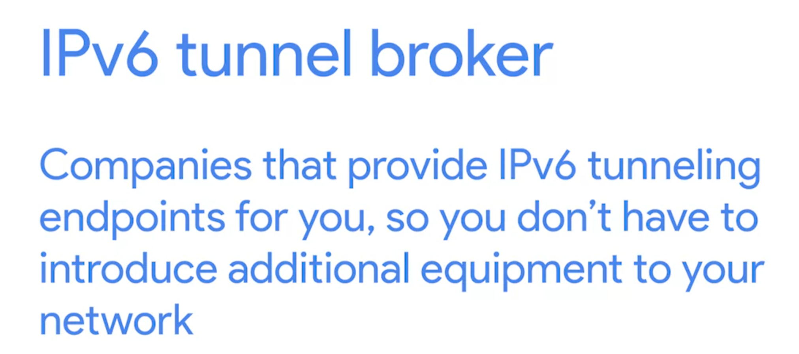
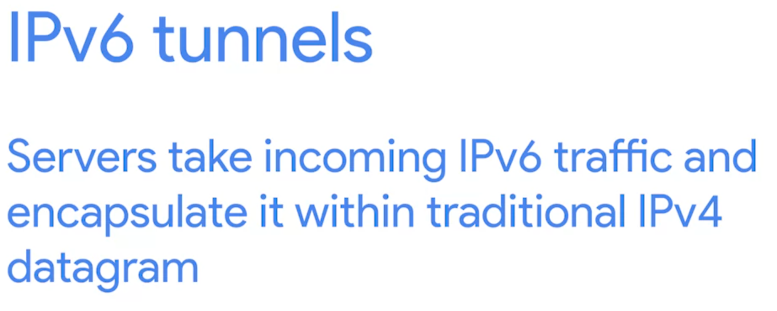
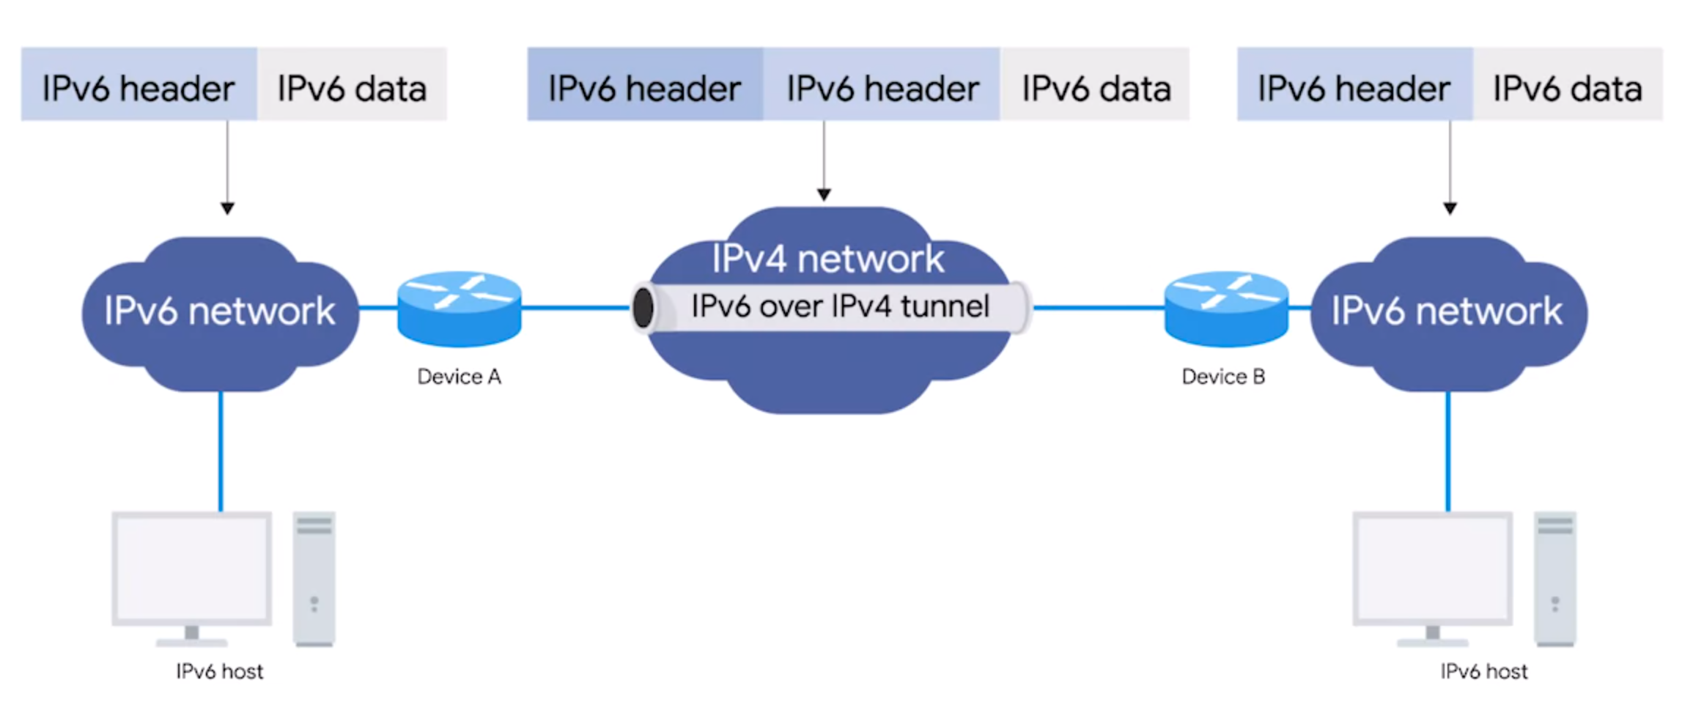
IPV4 and IPV6 Co-exist
IPV4 Mapped Address

Slide 19
Supplemental Reading for IPv6 and IPv4 Harmony
While IPv6 adoption becomes more widespread, it'll need a way to travel over the old IPv4 remnants of the Internet backbone. The primary way this is achieved today is through IPv6 tunnels. IPv6 tunnels are conceptually pretty simple. They consist of IPv6 tunnel servers on either end of a connection. These IPv6 tunnel servers take incoming IPv6 traffic and encapsulate it within traditional IPv4 datagrams. This is then delivered across the IPv4 Internet space where it's received by another IPv6 tunnel server. That server performs the de-encapsulation and passes the IPv6 traffic further along in the network.
There are a lot of competing protocols to be used for these kinds of IPv6 tunnels. Since this is still a new and evolving space, it's not clear who the winner will be. Some of the main competitors are 6in4, Tunnel Setup Protocol, and Anything in Anything (AYIYA).

